Slide 1
Department of Computer Science and Engineering Amrita School of Computing Movie Recommendation system using content based and collaborative based filtering
Team Members :
Gottumukkala Amrutha (19103)
ASL Manasa (19148)
Birat Chapagain (19154)
Rohit Kumar Sah (19155)
Project Guide :
Dr A. Padmavathi
Assistant Professor(SG)

Slide 2
Flow of Presentation
Abstract
Objective
Introduction
Literature Survey
Existing work with limitations
Proposed Work
Novelty of the Project
Software and hardware Requirement
System architecture
Implementation and results
References

Slide 3
Abstract
A new movie recommendation system has been developed using movie descriptions and various features. It provides highly accurate and personalized recommendations based on movie description analysis as compared to other models. The system's use of additional factors like cast, director, country, rating, and genre further enhances its tailored suggestions. Overall, it significantly improves the movie watching experience by delivering precise and individualized recommendations.

Slide 4
Objective
The objective is to develop a movie recommendation system that provides highly accurate and personalized suggestions based on movie descriptions and various features. By analyzing movie descriptions, the system aims to understand user preferences and improve recommendation accuracy.

Slide 5

Introduction
With the ever increasing volume, complexity and availability of online information, recommendation systems have been an effective solution to overcome such information overload.
Recommendations to the active client in the Collaborative Filtering approach are focused on items/products that other users with common preferences have enjoyed in the past.

Slide 6

The Content-Based model suggests products to the active user based on items he has already enjoyed.
Description analysis of movies is done for the better recommendation

Slide 7
Literature Survey
Reference Books | Ideology | Pros | Cons
[1] Hybrid recommendation system combined content-based filtering and collaborative prediction using artificial neural network Year - 2021 , Author - Afoudi, Yassine | The paper describes a hybrid recommendation system that combines content-based filtering and collaborative filtering using artificial neural networks. It uses an artificial neural network to learn the representations of items and users, and is evaluated using a dataset of movies. The results are compared with traditional content-based and collaborative filtering methods. | The use of a hybrid approach that combines the strengths of both content-based and collaborative filtering. The use of artificial neural networks to learn the representations of items and users Evaluation of the system using a real-world dataset. | The paper is from 2018, so the research is not up-to-date with the latest advancements in the field. The results are based on a specific dataset of movies, which limits the generalizability of the findings.

Slide 8
Literature Survey
Reference Books | Ideology | Pros | Cons
[2] Collaborative Filtering Recommender Systems Year - 2011 , Author - Ekstrand, Micheal | The paper is about collaborative filtering for recommender systems and covers the history, algorithms, evaluation tools, and challenges of using such systems. It emphasizes the importance of considering specific tasks, information needs, and item domains when designing and evaluating recommenders and provides guidance on best practices. The paper aims to provide an introduction to the important issues underlying recommenders. | Collaborative filtering is a powerful method for enabling users to filter through large information and product spaces. Provides personalized recommendations based on the user's past behaviour and similar users' behaviour. | May not take into account other important factors such as new and trending items. Can suffer from the "cold start" problem for new users with no past behaviour.

Slide 9
Literature Survey
Reference Books | Ideology | Pros | Cons
[3] Item-Based Collaborative Filtering Recommendation Algorithms Year - 2001 , Author - Sarwar, Badrul, | Item-based techniques first analyse the user-item matrix to identify relationships between different items and then use these relationships to indirectly commute recommendations for users. Different item-based recommendation generation algorithms are used. Different techniques for item-item similarities(item-item correlation vs cosine similarities between item vectors)and different techniques for obtaining recommendations from them(weighted sum vs regression model). | Item-based algorithms provide dramatically better performance than user-based algorithms. The proposed algorithm provides better quality of recommendation than the best available user-based algorithms. | The item-item scheme provides better quality of predictions than the user-user scheme but the improvement is not significantly large.

Slide 10
Literature Survey
Reference Books | Ideology | Pros | Cons
[4] An entropy-based neighbor selection approach for collaborative filtering Year - 2022 , Author - Pavitha | Traditional collaborative filtering algorithms solely utilize entity similarities in order to form neighbourhoods. In this paper an entropy-based neighbour selection approach which focuses on measuring uncertainty of entity vectors. Such uncertainty can be interpreted as how a user perceives rating domain to distinguish her tastes or diversification of items’ rating distributions. The proposed method takes similarities into account along with such uncertainty values and it solves the optimization problem of gathering the most similar entities with minimum entropy difference within a neighbourhood. | The proposed method can significantly improve traditional k-NN-based collaborative filtering methods without worsening online performance. The proposed approach can also be integrated with other compatible previous methods. | The paper does not mention any potential limitations of the proposed model or any areas where it may not perform as well.

Slide 11
Literature Survey
Reference Books | Ideology | Pros | Cons
[5] Movie recommendation and sentiment analysis using machine learning Year - 2014 , Author - Kaleli, Cihan | This paper presents a new model for recommending movies and TV shows on streaming sites by utilizing social network data and mining user preferences expressed in microblogs. It is the first attempt to connect the movie and TV watching domain with social network activities and can solve the "cold-start" problem in movie and TV recommendation systems. The model uses data mining and social computing models and can be easily applied to online media streaming sites for personalized recommendations to customers. | The use of the Cosine Similarity algorithm for movie recommendation, which has shown to be accurate in recommending related movies based on various factors. The use of both the Naive Bayes and Support Vector Machine algorithms for sentiment analysis, which allows for comparison and selection of the best algorithm for classifying reviews. The inclusion of prospects for future improvement such as increasing the accuracy of sentiment analysis for handling sarcastic or ironic reviews and expanding the analysis to other languages. | The limitation of the movie recommendation system as if the movie entered by the user is not present in the dataset or if the name is not entered in the same format as in the dataset. The limitation of the sentiment analysis to only English reviews and difficulty in correctly classifying sarcastic or ironic reviews. The lack of consideration for user preferences in movie recommendations.

Slide 12
Literature Survey
Reference Books | Ideology | Pros | Cons
[6] Combining Collaborative Filtering with Personal Agents for Better Recommendations, Year - 1999 , Author - Nathaniel G | Information filtering (IF) focuses on the analysis of item content and the development of a personal user interest profile. Collaborative filtering (CF) focuses on identification of other users with similar tastes and the use of their opinions to recommend items. In this paper we can identify that a CF framework can be used to combine personal IF agents and the opinions of a community of users to produce better recommendations than either agents or users can produce alone. | It becomes less important to invent a brilliant agent, instead we can simply invent a collection of useful ones. | It cannot efficiently handle “users” who rate all items and re-rate them frequently as they "learn."

Slide 13
Literature Survey
Reference Books | Ideology | Pros | Cons
[7] A Hybrid Approach using Collaborative filtering and Content based Filtering for Recommender System Year - 2018 , Author - Geetha, G | This paper presents a hybrid movie recommendation system that uses a combination of content-based filtering and collaborative filtering to make more precise recommendations to users. The system mines movie databases to gather information such as popularity and attractiveness. The authors propose that the system can cater to both new and existing users, and based on informal evaluations with a small set of users, the system has received a positive response. However, further testing and evaluation is needed with a larger dataset. The potential for the system to be applied to other domains is also suggested. | The proposed movie recommendation system uses a hybrid approach, which combines both content-based and collaborative filtering, to provide more accurate recommendations to users. The system takes into account various attributes such as popularity and attractiveness, which are important factors in movie recommendation. The system can recommend movies to both new and existing users. | The performance of the system is difficult to evaluate as there is no right or wrong recommendation, it is just a matter of opinions. The authors mention that the system was only informally evaluated with a small set of users, so more meaningful results would require a larger data set.

Slide 14
Literature Survey
Reference Books | Ideology | Pros | Cons
[8] A personalized movie recommendation system based on collaborative filtering Year - 2017 , Author - Subramaniyaswamy, V | The paper presents a recommendation engine that utilizes collaborative filtering techniques to suggest movies to users. The system uses standard user demographics such as gender, age, and occupation, as well as user ratings to identify other users with similar tastes. Recommendations are made based on the best-rated movies of the nearest neighbor and are also made time-sensitive. The results of the experiment on the MovieLens dataset show that the proposed model generates more personalized movie recommendations compared to other models.. | It is based on collaborative filtering, which is a widely used and promising approach for building recommendation systems. The system uses standard user demographics such as gender, age, and occupation, which can provide valuable information for making recommendations. | The system only considers a limited set of user demographics, and more information such as nationality, race, location, mother-tongue, and languages spoken could be used to make recommendations more personalized. The system relies on user ratings to make recommendations, but input from other sources such as consolidated internet databases and authentic review sites could also be used to improve recommendations.

Slide 15
Literature Survey
Reference Books | Ideology | Pros | Cons
[9] Research on Collaborative Filtering Recommendation Algorithm Based on Mahout and User Model Year - 2020 , Author - Song, Bo | While working on collaborative learning , system administrators only need to implement the machine learning algorithm based on the user model according to the rules of the training sample instead of doing a lot of repeated calculation.In order to optimize the system and implement a collaborative filtering algorithm on the cloud computing platform, we chose Hadoop platform as the basis for implementation. | Not only solves practical problems but also implements more an effective and more personalized recommendation for users | In the construction of the online recommendation field, model-based algorithms has essential reference values to improve the quality and speed of user search information.

Slide 16
Literature Survey
Reference Books | Ideology | Pros | Cons
[10] A Recommendation Model Based on Deep Neural Network Year - 2018 , Author -Zhang, Libo | This paper proposes a model combining a collaborative filtering recommendation algorithm with deep learning technology, therein consisting of two parts. First, the model uses a feature representation method based on a quadric polynomial regression(QPR) model, which obtains the latent features more accurately by improving upon the traditional matrix factorization algorithm. Then, these latent features are regarded as the input data of the deep neural network model, which is the second part of the proposed model and is used to predict the rating scores.to customers. | Compared with other recommendation algorithms on three public datasets, it is verified that the recommendation performance has been effectively improved by the proposed model. The framework developed is simple and generic, therefore, it is not limited to the method presented in this paper. One can regard the framework as a guideline for developing deep learning methods for recommendation systems. | When the feature dimension is low, the features learned by our model are not sufficiently accurate, and there remains significant room for improvement. If more than 2 hidden layers are used, the performance of the model is almost no longer improved.

Slide 17
Existing Work with Limitations
The recommendation systems used “K-nearest neighbour” algorithm for recommending movies in Collaborative filtering approach and for the Content based Filtering “Cosine similarity” was used to recommend according to the user taste.
The limitations of the existing recommended system include:
Cold start problem
Data sparsity

Slide 18
Proposed Work
GUI based application
4
Implementation of REST API on top of the model.
3
Content based & Collaborative Filtering
2
Exploratory Data Analysis
1

Slide 19
Novelty of the Project
Description analysis will be used here to improve the models based on the movie description.
Adding various features to improve the movie recommendations.

Slide 20










Software and Hardware Requirements
Nextjs (React)
Vercel
Chakra UI
TMDB - The Movie Database
Movie Lens

Slide 21
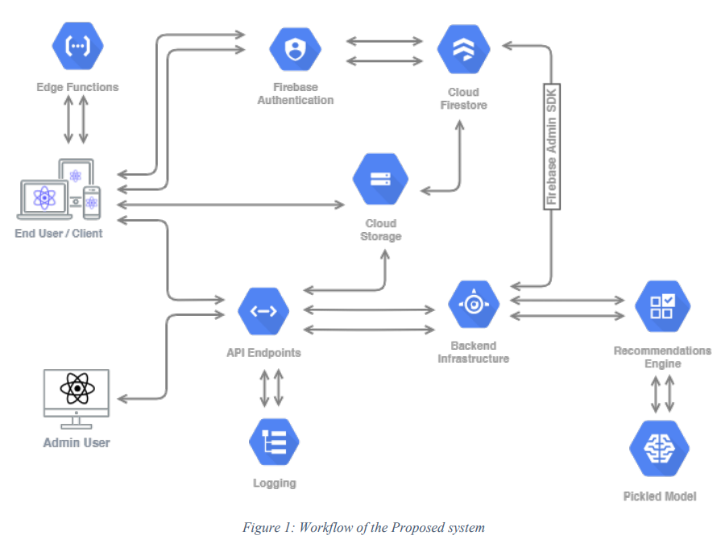
System Architecture

Slide 22
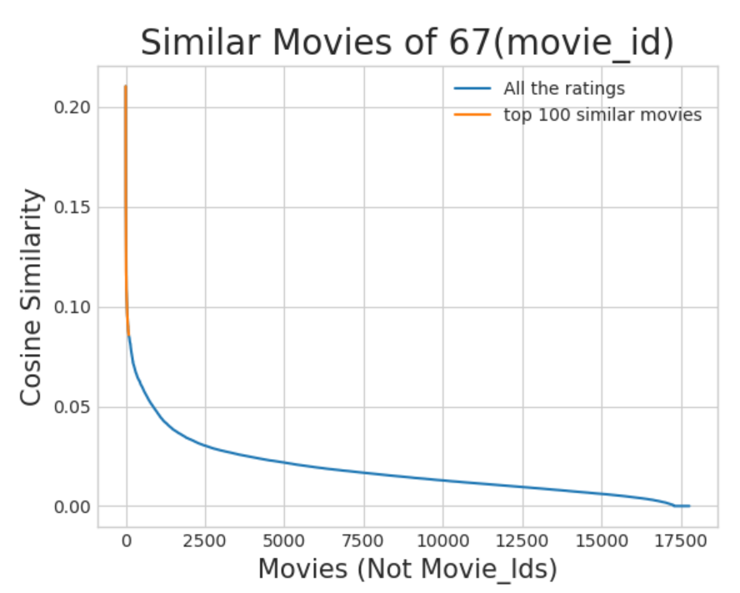
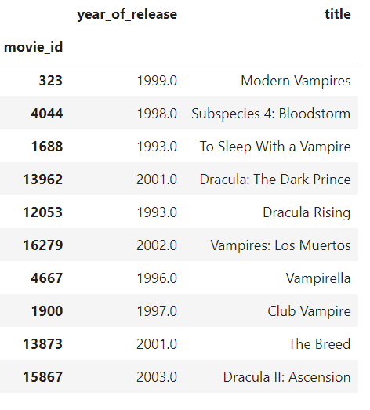
Implementation
Cosine Similarity

Slide 23
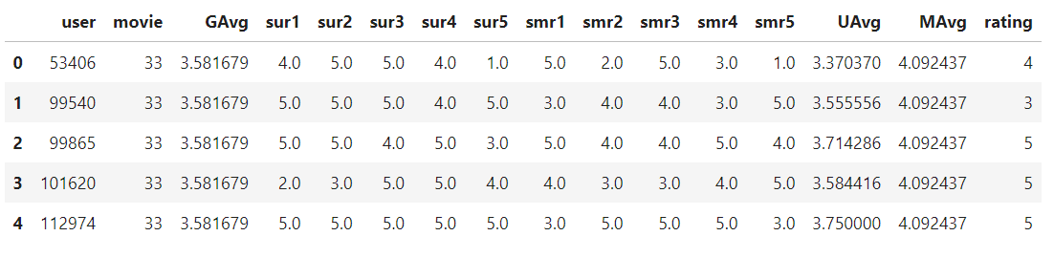

Slide 24
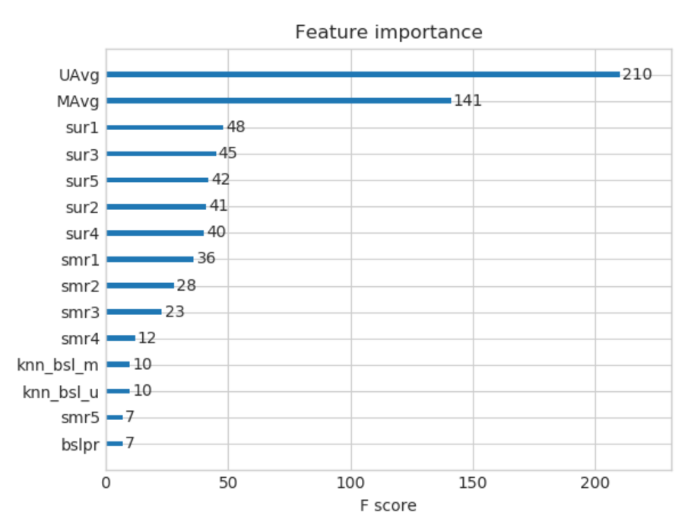

Slide 25
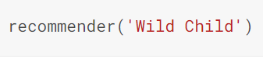
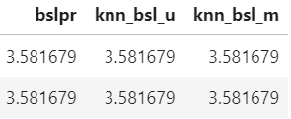
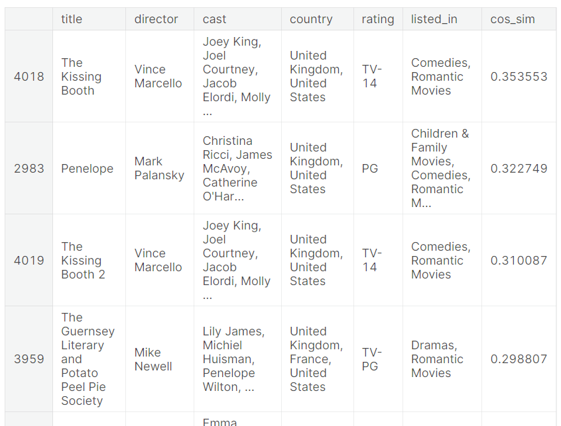

Slide 26
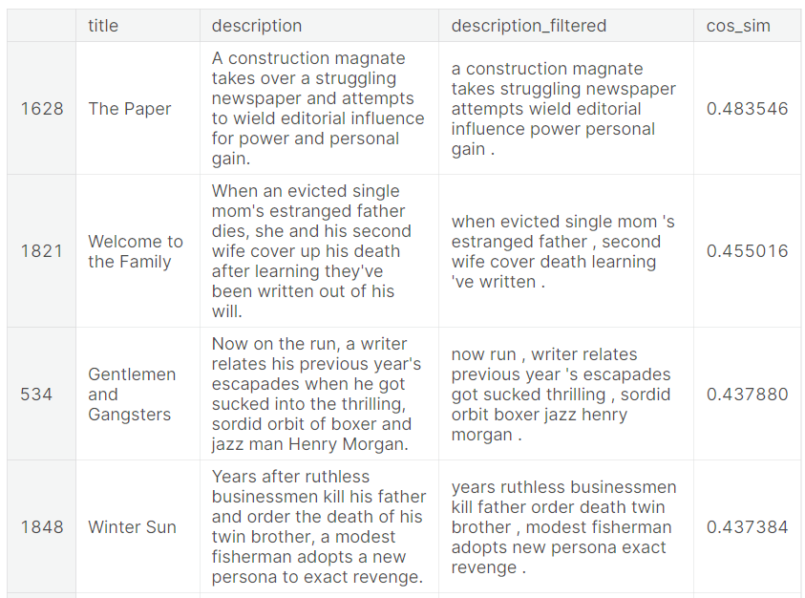


Slide 27
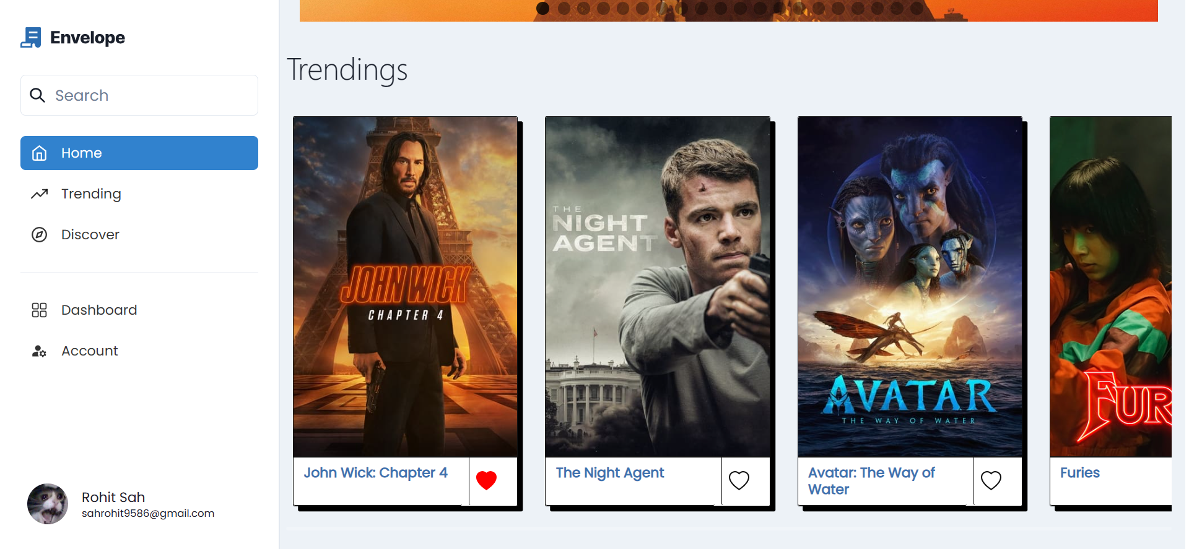
Frontend

Slide 28


Slide 29
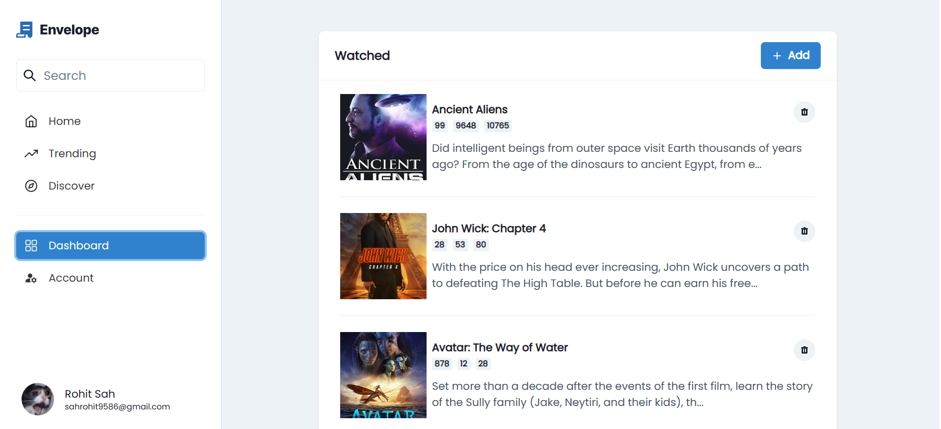

Slide 30
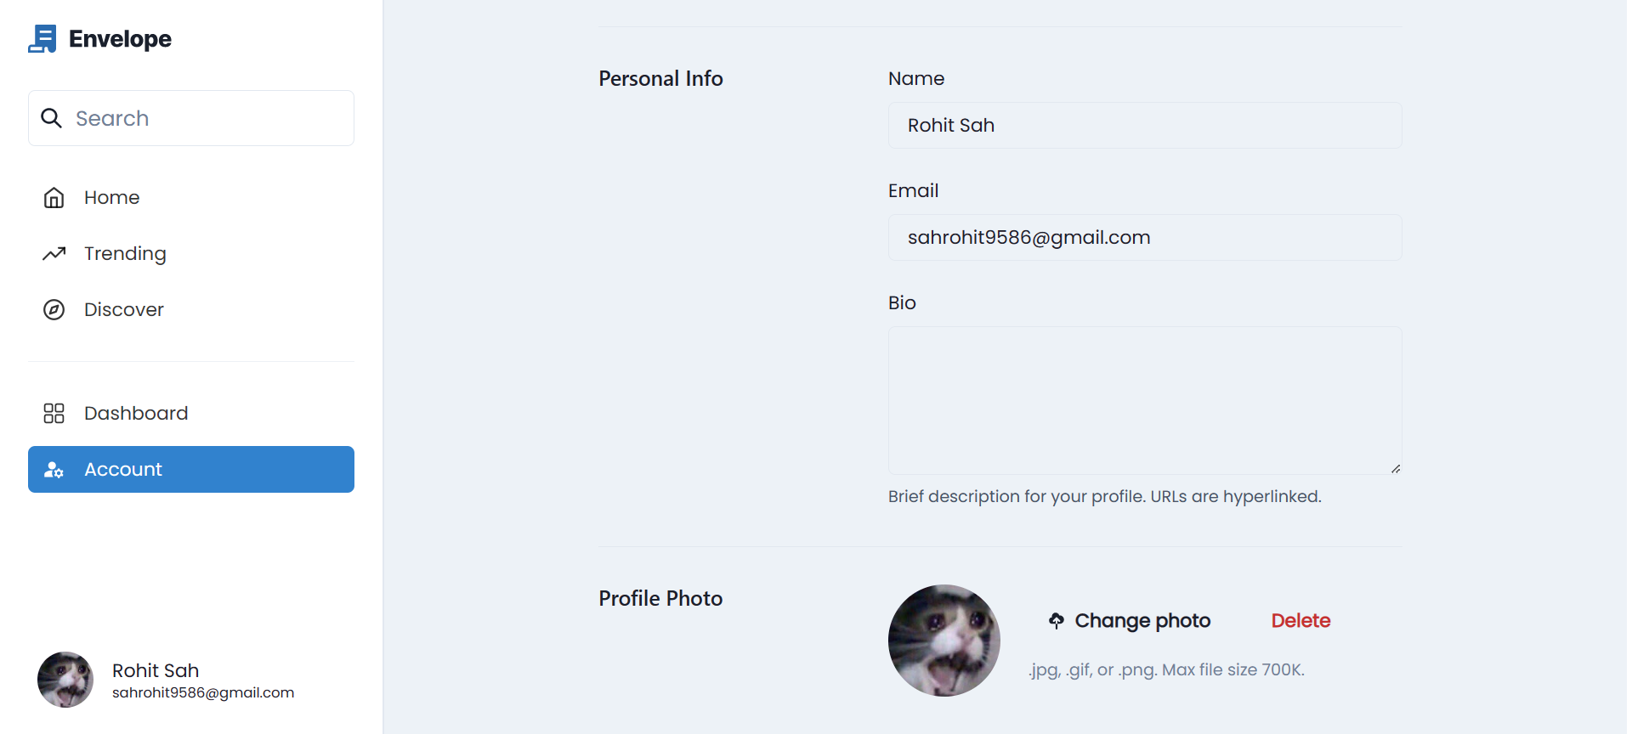

Slide 31
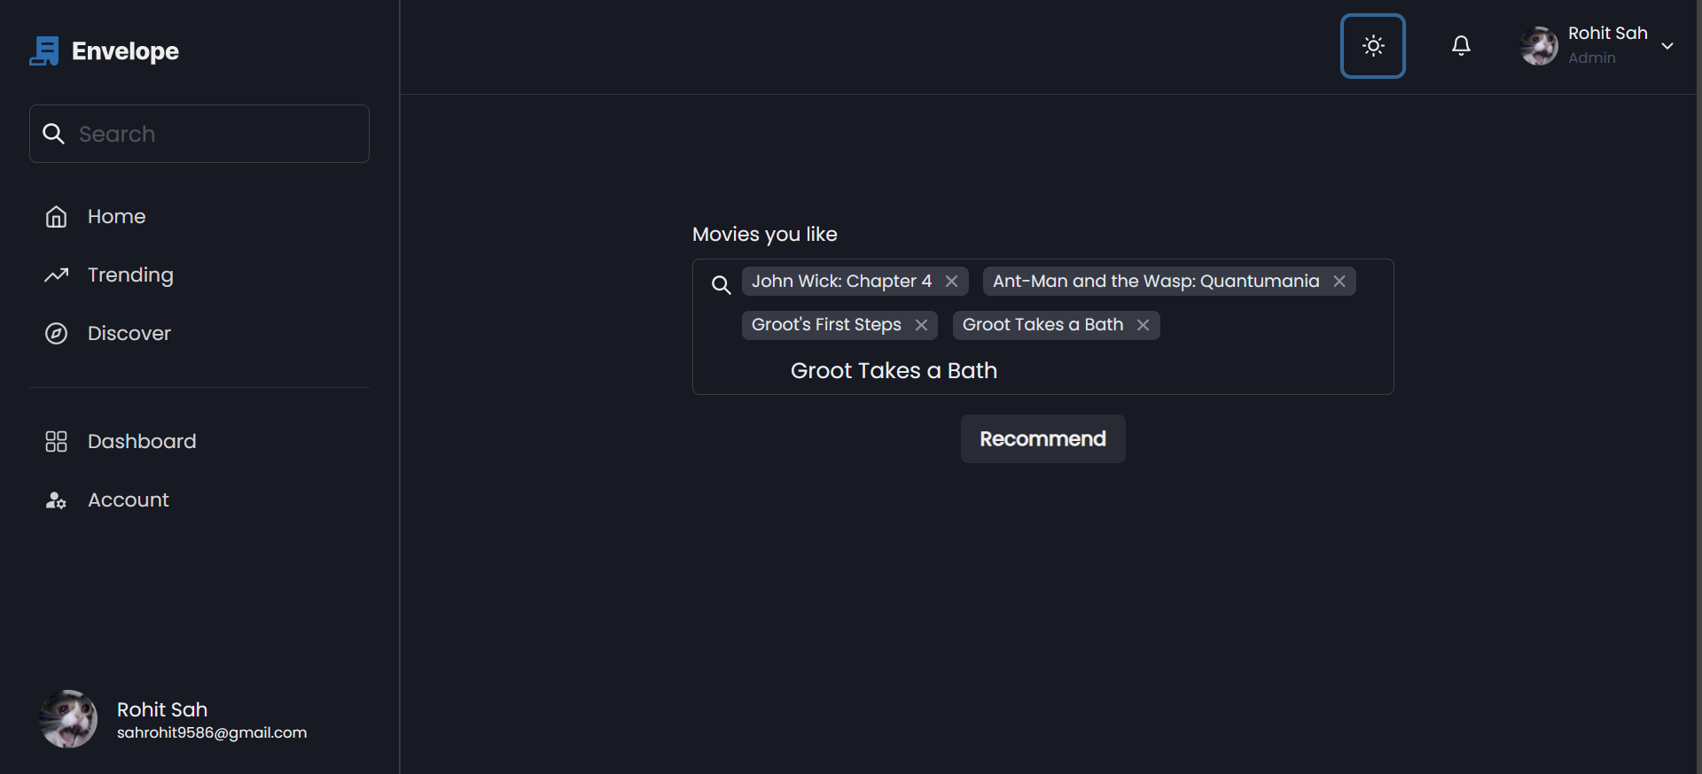

Slide 32
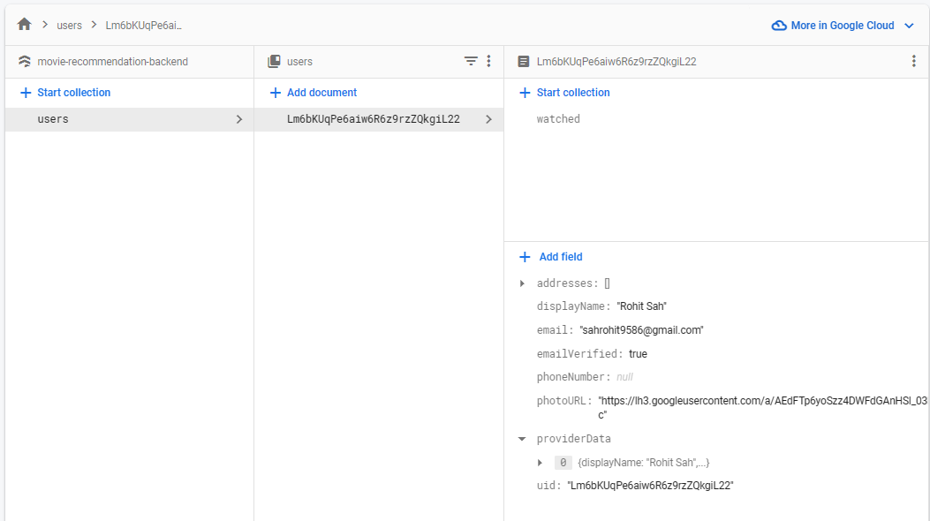

Slide 33
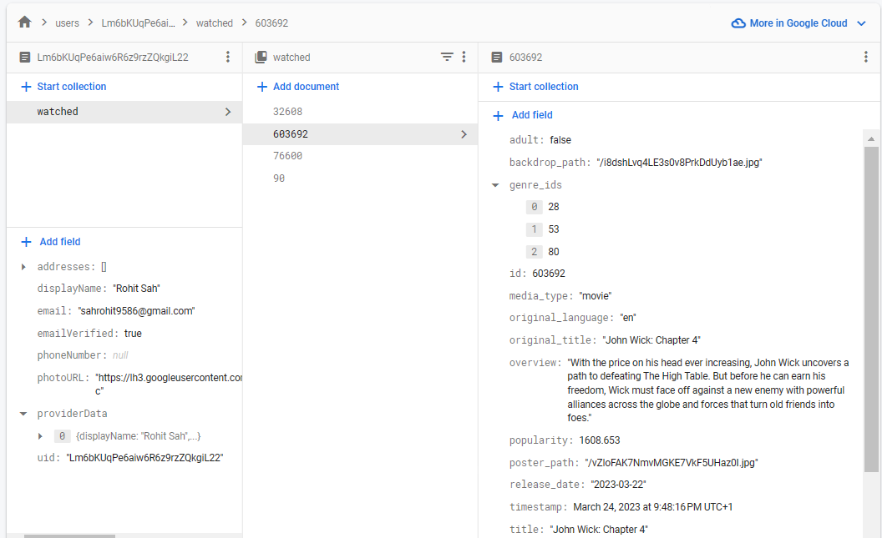

Slide 34
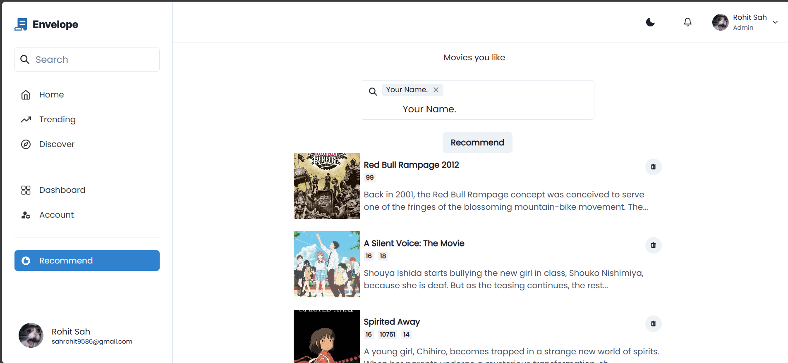

Slide 35
Implementations
DEMO
https://recommend-movies.vercel.app/

Slide 36
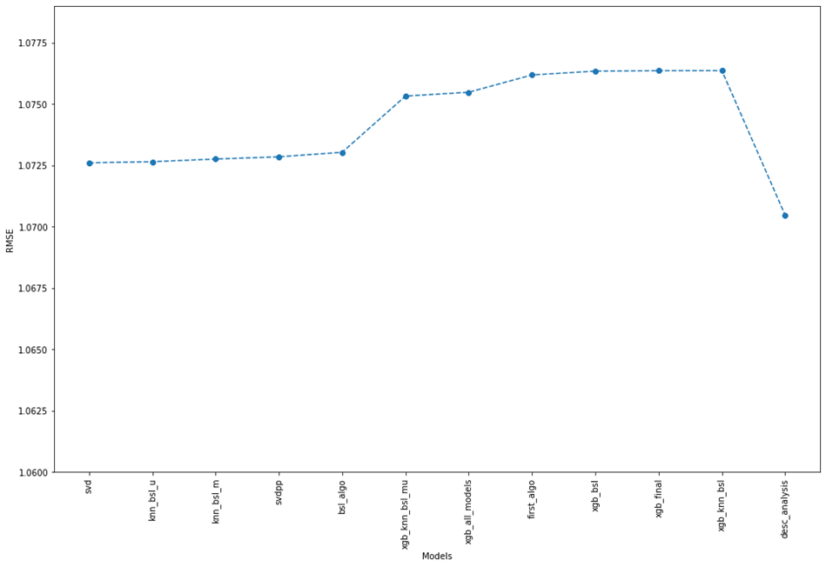
Result
In summary, a movie recommendation system was implemented using various machine learning models such as SVM, KNN, Surprise Baseline Predictor, Matrix Factorization, and XGBoost. However, a description analysis model along with cast, director, country, rating, and genres as features was found as the best one in terms of RMSE value. This model was used to recommend movies to users and this model was implemented in our project finally.

Slide 37
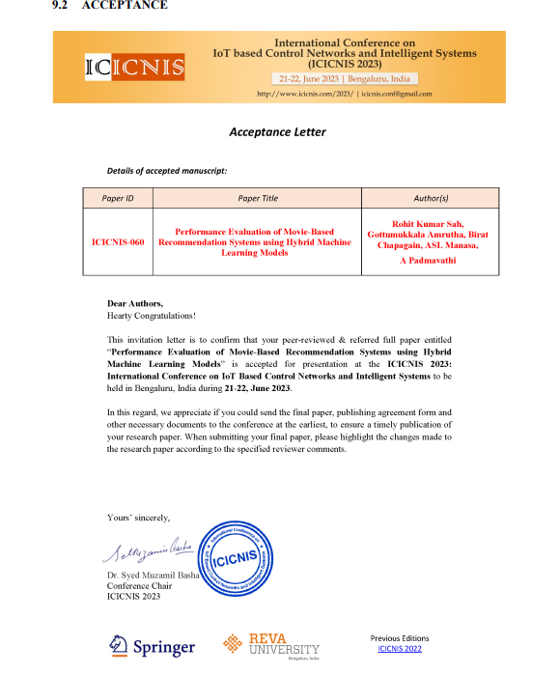

Slide 38
References
Afoudi, Yassine, et al. “Hybrid Recommendation System Combined Content-based Filtering and Collaborative Prediction Using Artificial Neural Network.” Simulation Modelling Practice and Theory, vol. 113, Elsevier BV, Dec. 2021, p. 102375. Crossref, https://doi.org/10.1016/j.simpat.2021.102375.
Ekstrand, Michael D. “Collaborative Filtering Recommender Systems.” Foundations and Trends® in Human–Computer Interaction, vol. 4, no. 2, Now Publishers, 2011, pp. 81–173. Crossref, https://doi.org/10.1561/1100000009.
Sarwar, Badrul, et al. “Item-based Collaborative Filtering Recommendation Algorithms.” Proceedings of the 10th International Conference on World Wide Web, USA, ACM, Apr. 2001. Crossref, https://doi.org/10.1145/371920.372071.
Pavitha, N., et al. “Movie Recommendation and Sentiment Analysis Using Machine Learning.” Global Transitions Proceedings, vol. 3, no. 1, Elsevier BV, June 2022, pp. 279–84. Crossref, https://doi.org/10.1016/j.gltp.2022.03.012.
Kaleli, Cihan. “An Entropy-based Neighbor Selection Approach for Collaborative Filtering.” Knowledge-Based Systems, vol. 56, Elsevier BV, Jan. 2014, pp. 273–80. Crossref, https://doi.org/10.1016/j.knosys.2013.11.020.

Slide 39
References
Nathaniel G.et al. “Combining Collaborative Filtering with Personal Agents for Better Recommendations” AAAI-99 Proceedings, 1999
Geetha, G., et al. “A Hybrid Approach Using Collaborative Filtering and Content Based Filtering for Recommender System.” Journal of Physics: Conference Series, vol. 1000, IOP Publishing, Apr. 2018, p. 012101. Crossref, https://doi.org/10.1088/1742-6596/1000/1/012101.
Subramaniyaswamy, V., et al. “A Personalised Movie Recommendation System Based on Collaborative Filtering.” International Journal of High Performance Computing and Networking, vol. 10, no. 1/2, Inderscience Publishers, 2017, p. 54. Crossref, https://doi.org/10.1504/ijhpcn.2017.083199.
Song, Bo, et al. “Research on Collaborative Filtering Recommendation Algorithm Based on Mahout and User Model.” Journal of Physics: Conference Series, vol. 1437, no. 1, IOP Publishing, Jan. 2020, p. 012095. Crossref, https://doi.org/10.1088/1742-6596/1437/1/012095.
Zhang, Libo, et al. “A Recommendation Model Based on Deep Neural Network.” IEEE Access, vol. 6, Institute of Electrical and Electronics Engineers (IEEE), 2018, pp. 9454–63. Crossref, https://doi.org/10.1109/access.2018.2789866.

Slide 40
Thank You

